Slide 1



K. J. Somaiya Institute of Information Technology, Mumbai
Department of Electronics and Telecommunication Engineering
Third Year Mini Project Presentation (Sem 5)
Academic Year 2023-24
TEXT TO BRAILLE CONVERTER
Vedant Hedaoo(A-31)
Aditya Jain(A-35)
Ankit Kale (A-39)
Shankar Kannan(A-40)
Supervisor
Prof.Pranali Hatode

Slide 2

Outline of Project
Introduction
Components
Background
Block Diagram
Working
Estimated Cost
Conclusion
References

Slide 3
Introduction
A Text to Braille generation device is a revolutionary assistive technology designed to bridge the communication gap for individuals with visual impairments.
This innovative device translates spoken words or text into Braille, a tactile writing system used by the blind and visually impaired.By converting text into Braille characters, it empowers users to access written information and engage in effective communication.
This technology opens doors to education, employment, and social interaction, enhancing the independence and inclusivity of individuals with visual disabilities.

Slide 4
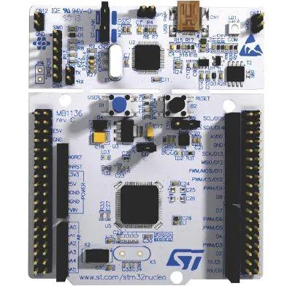
Components
STM32 Nucleoboard
USB To serial port converter
HC-05 bluetooth module
Jumper Wire
Breadboard

Slide 5
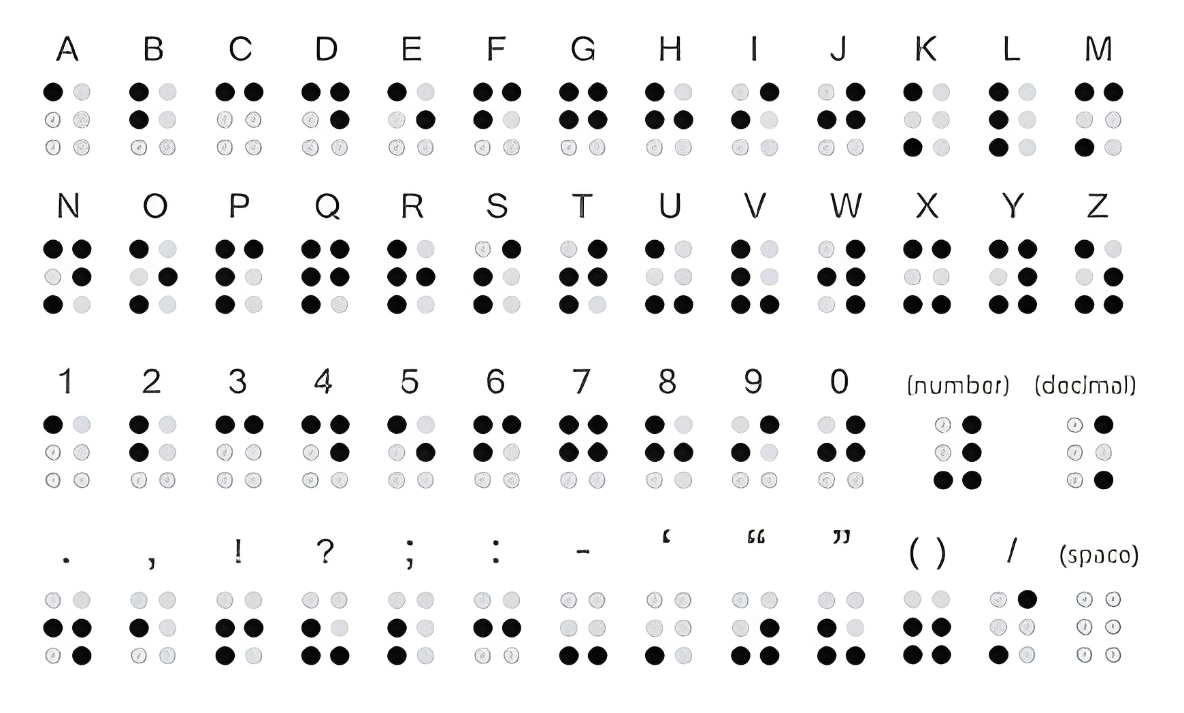
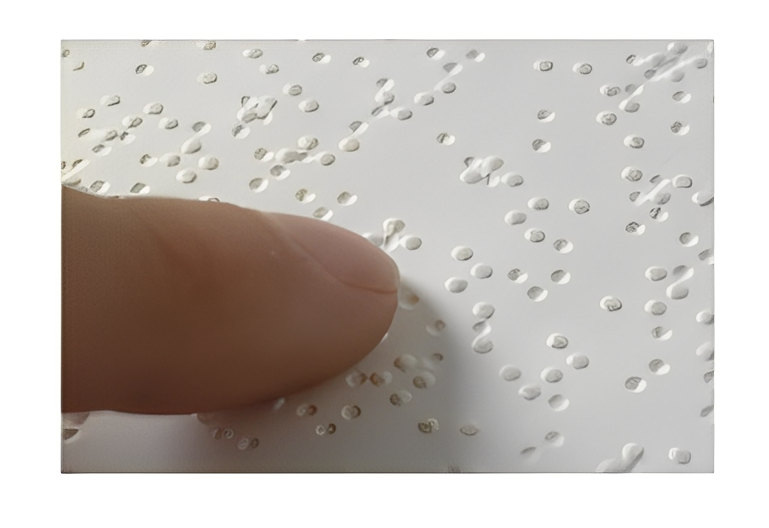
Background
Braille is a form of written language for blind people, in which characters are represented by patterns of raised dots that are felt with the fingertips. It is traditionally written with embossed paper. Braille users can read computer screens and other electronic supports using refreshable braille displays.
We are going to use an ARM cortex m series board & Google's API to convert voice signal (speech) into braille so that a visually as well as auditorily impaired person could understand conversations in real time.
`

Slide 6
BRAILLE FORM OF ALL THE LETTERS

Slide 7
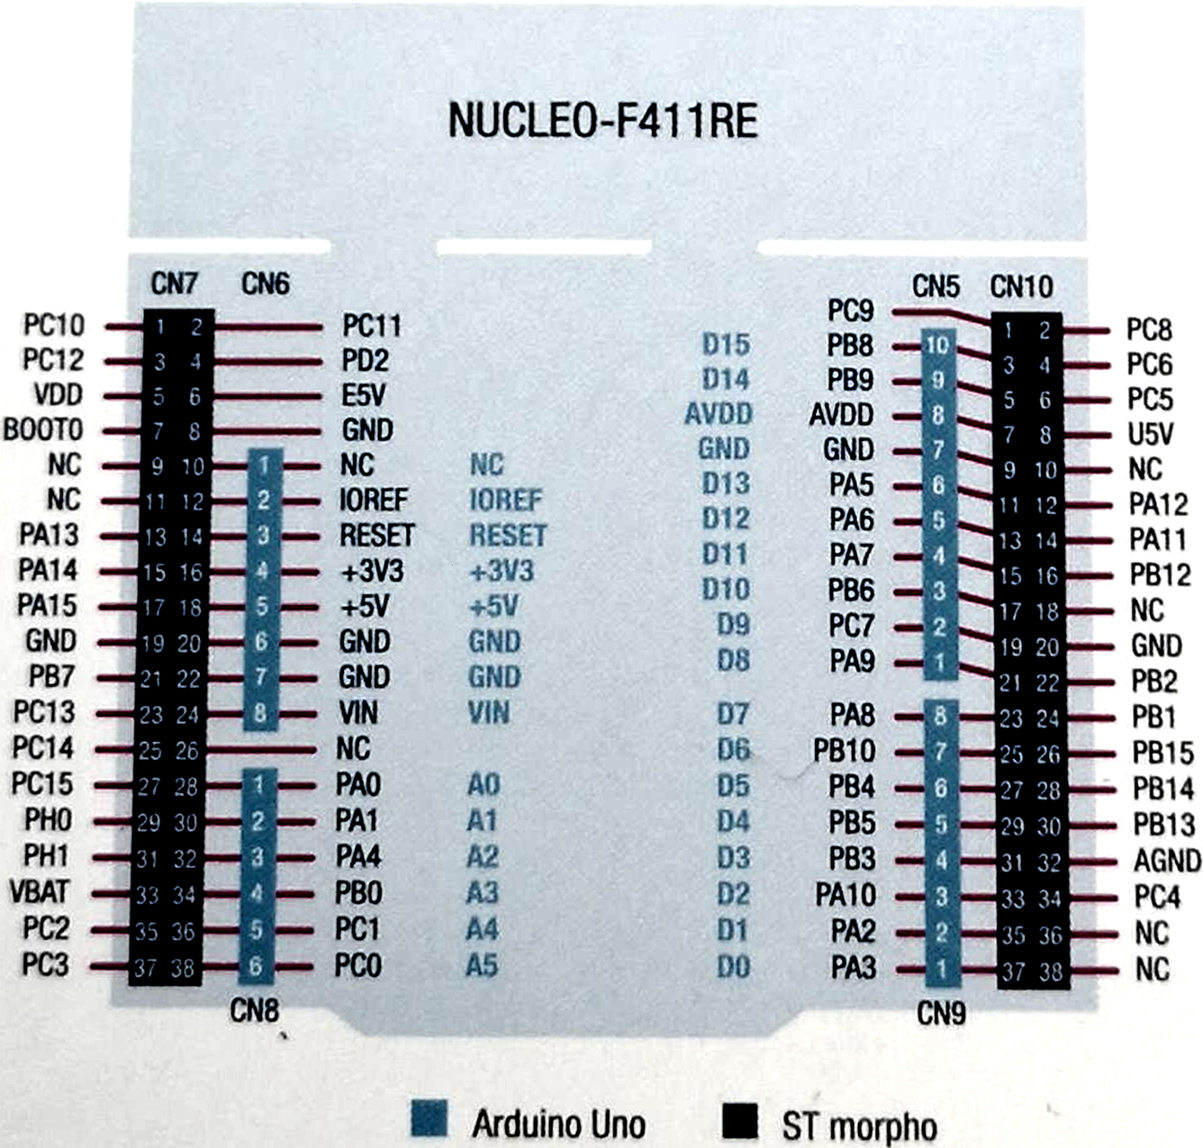
STM -32 Nucleoboard

Slide 8

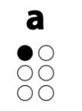
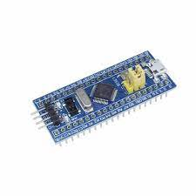


Block Diagram
Text
Braille
Application
STM-32
Bluetooth Tx
Bluetooth
Module

Slide 9
Working
First we will connect mobile to the Hc-05 bluetooth module .
Then we will take text input from the user.
Using a Bluetooth module it is sent to STM32 Board.
Then the STM32 is programmed to convert the text input into an electric signal that can operate some mechanical entities.
Then we used the electrical signal to run LED arrays to represent the braille output.
With the form of led we will get alphabet will be represented.

Slide 10
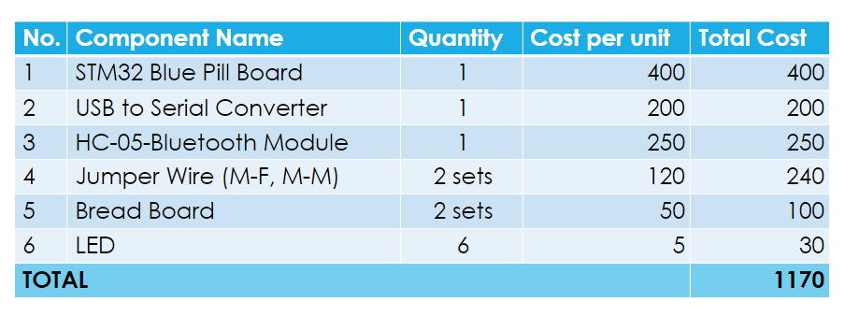
Estimated Cost
STM 32 Nucleo 64 Board
1
1400
1400
2200

Slide 11
FUTURE MODIFICATIONS
Multi-Language Support: Extend the converter's capabilities to support multiple languages and Braille codes, ensuring it can accommodate a global user base.
Audio Input: Incorporate the option for the speech -to-Braille converter to read the translated Braille text aloud to assist users with visual impairments.
Support for Special Symbols: Ensure that the converter can accurately translate special symbols, mathematical notations, and other non-standard characters into Braille.
Real-Time Feedback: Implement a feature that provides real-time feedback to users as they input text, helping them understand how their text will be represented in Braille.
Cloud-Based Collaboration: Develop a cloud-based platform that allows users to collaborate and share Braille documents, making it easier for students and professionals to work together.

Slide 12
Conclusion
In conclusion, the Real-Time Text to Braille Converter Project represents a significant step forward in enhancing accessibility and inclusivity for individuals with visual impairments. This innovative technology bridges the communication gap between the hearing and visually impaired communities, opening up new opportunities for interaction and engagement in various aspects of life.
We believe that our project has the potential to revolutionize the lives of countless individuals with visual impairments, fostering greater independence and breaking down barriers to communication. By continuing to refine and develop this technology, we can contribute to a more inclusive society where every voice is heard and every idea is shared, regardless of one's abilities.

Slide 13
References
https://www.pharmabraille.com/pharmaceutical-braille/the-braill
e-alphabet/?fbclid=IwAR3SS8YF3_kZux5v6bnNMNo-wnpGoh1GB50
j5e2kXFpupc16m87o4xzOChY
An IoT Based System for Printing Braille Letter from Speech:
https://ieeexplore.ieee.org/document/9230734/
https://libbraille.org/how-alphabets-and-numbers-are-written-in-th
e-script/ https://www.st.com/resource/en/data_brief/stm32cubeide.pdf

Slide 14


